Slide 1
Hands-On Workshop: Mastering Kinetis SDK — Advanced
FTF-DES-F1147
Anthony Huereca | Freescale Applications Engineer
Eric Ocasio | Freescale Business Development Engineer
JUNE.2015

Slide 2
Agenda
In-Depth Kinetis SDK
Advanced Kinetis SDK Project Creation
Lab
In-Depth on Kinetis SDK System Services
Lab
Middleware Stacks
In-Depth on Kinetis SDK Startup and Porting
Lab
Tips and Tricks
Conclusion

Slide 3
Class Notes
Presentation and Lab Guides are on Desktop under “KSDK Advanced” folder
Presentation can also be found at www.freescale.com/ftf
Please leave boards on table after class as they will be used at other events
Computer Password: CodeWarrior1

Slide 4
Kinetis SDK Classes
Name | Class Number | Date | Time | Room
Getting Started with Kinetis SDK - Basic | FTF-DES-F1146a | Monday | 1:00PM-5:15PM | Griffin 7
Optimizing Your Kinetis SDK Application with FreeRTOS | FTF-DES-F1301b | Monday | 1:00PM-3:00PM | Griffin 6
Create Secure Network-Connected Embedded Systems with CyaSSL and Kinetis SDK | FTF-INS-F1145 | Monday | 1:00PM-3:00PM | Griffin 2
Choosing FreeRTOS and Kinetis SDK for Your Next Design | FTF-DES-F1120 | Monday | 4:15PM-5:15PM | Lonestar Ballroom B
Mastering Kinetis SDK - Advanced | FTF-DES-F1147b | Monday | 5:30PM-9:00PM | Griffin 7
Optimizing Your Kinetis SDK Application with FreeRTOS | FTF-DES-F1301a | Tuesday | 11:00AM-1:00PM | Griffin 6
Mastering Kinetis SDK - Advanced | FTF-DES-F1147a | Tuesday | 2:30PM-6:45PM | Griffin 7
Getting Started with MQX™ RTOS for Kinetis SDK | FTF-DES-F1144a | Wednesday | 2:30PM-5:45PM | Griffin 7
Getting Started with Kinetis SDK - Basic | FTF-DES-F1146b | Thursday | 8:00AM-12:00PM | Griffin 6
Getting Started with MQX™ RTOS for Kinetis SDK | FTF-DES-F1144b | Thursday | 9:00AM-12:00PM | Griffin 7

Slide 5
Kinetis Software Development Kit (KSDK)

Slide 6
What is an SDK for and why it’s needed ?
In general, an SDK is a package of pre-written code that developers can re-use in order to minimize the amount of unique code that they need to develop themselves
It can help to prevent unnecessary duplication of effort in a development team or community
It has a common application programming interface (API) for different platforms or peripherals, what shortens the application developing time
Thanks to use of abstraction layers it’s more intuitive and concise for programmers

Slide 7



Kinetis Software Development Kit (SDK)
Learn more at: www.freescale.com/KSDK
A complete software framework for developing applications across all Kinetis MCUs
Product Features
Open source Hardware Abstraction Layer (HAL) provides APIs for all Kinetis hardware resources
BSD-licensed set of peripheral drivers with easy-to-use C-language APIs
Comprehensive HAL and driver usage examples and sample applications for RTOS and bare-metal.
CMSIS-CORE compatible startup and drivers plus CMSIS-DSP library and examples
RTOS Abstraction Layer (OSA) with support for Freescale MQX, FreeRTOS, Micrium uC/OS, bare-metal and more
Integrates USB and TCP/IP stacks, touch sensing software, encryption and math/DSP libraries, and more
Support for multiple toolchains including GNU GCC, IAR, Keil, and Kinetis Design Studio
Integrated with Processor Expert
SDK
HAL, peripheral drivers, libraries, middleware, utilities, and usage examples; delivered in C source
Software and Hardware
Evaluation & Dev Tools
Customer Application
Stacks
(TCP/IP, USB)
Middleware
Application Specific
Libraries
(DSP, Math, Encryption)
Operating System
BSP, Drivers & HAL
Bootloader
MCU Hardware
The OSI logo trademark is the trademark of Open Source Initiative.

Slide 8
Kinetis SDK Key Components
Two major components of the Kinetis SDK
Hardware Abstraction layer (HAL)
Peripheral Drivers
Supporting Components
CMSIS-compliant header files
System services (clock manager, interrupt manager, low power manager)
Operating System Abstraction (OSA) layer
Board Support Packages (BSP)
Stacks and Middleware

Slide 9
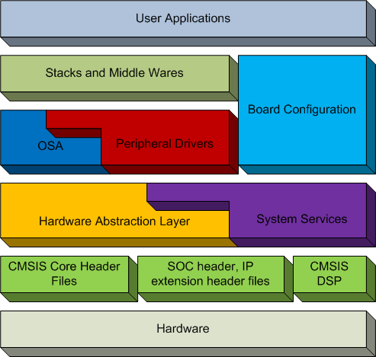
Kinetis SDK Overview
HAL
Abstracted IP level Basic operations.
Useable low level drivers.
System Services
Clock Manager, Interrupt manager, Low power manager, HW timer…
Can be used with HAL, PD and Application
FSL Peripheral Drivers
Use case driven high level drivers.
OS Abstraction Layer (OSA)
Adapt to different OS (MQX, FreeRTOS and uCos) through corresponding OSA
BSP & Configuration
Board Configuration, Pin Muxing, GPIO Configuration
Stacks & Middle Wares
USB stack, TCP/IP stack, BTLE…
Audio, Graphics, Boot Loader…
Note: The IP extension header files could be merged with the SoC header in later on KSDK releases…

Slide 10
HAL and Drivers
HAL is at a lower level than the Kinetis SDK drivers
No state awareness
Mostly macros to provide user-friendly naming to access MCU registers
Kinetis SDK drivers make use of HAL API to implement their functionality.
Freescale Kinetis SDK
Application
Drivers and OSA
HAL
SDK Startup code

Slide 11
HAL Overview
Create the basic abstraction layer over MCU internal peripherals
Each individual peripheral has own dedicated HAL
Full coverage of all peripherals features
Also implements the function for module initialization (reset)
Possible configurability
In compilation time via feature header files
In run-time by taking user defined configuration data through “init” function call
Does not implement the interrupt driven logic (ISR)
It’s implemented by Peripheral Drivers or User Application
User Application based only on HAL need to define own ISR entries
HAL Source at C:\Freescale\KSDK_1.2.0\platform\hal
HAL Library at C:\Freescale\KSDK_1.2.0\lib\ksdk_hal_lib

Slide 12
HAL Overview Continued
Mostly made up of macros and inline C functions
HAL leverages the Bit Manipulation Engine for increased code efficiency
HAL API uses the peripheral base address as argument
Base addresses already defined in device header file
Ex: I2C_HAL_Init(I2C1);

Slide 13
Example of HAL for SPI
void SPI_HAL_Init (uint32_t baseAddr)
uint32_t SPI_HAL_SetBaud (uint32_t baseAddr, uint32_t bitsPerSec, uint32_t sourceClockInHz)
void SPI_HAL_SetDataFormat(uint32_t baseAddr, spi_clock_polarity_t polarity,
spi_clock_phase_t phase,
spi_shift_direction_t direction)
static inline void SPI_HAL_Enable (uint32_t baseAddr)
static inline void SPI_HAL_Disable(uint32_t baseAddr)
static inline void SPI_HAL_SetMasterSlave(uint32_t baseAddr, spi_master_slave_mode_t mode)
static inline bool SPI_HAL_IsMaster(uint32_t baseAddr)
…
static inline void SPI_HAL_SetMatchIntCmd(uint32_t baseAddr, bool enable)
static inline bool SPI_HAL_IsMatchPending(uint32_t baseAddr)
…
static inline uint8_t SPI_HAL_ReadData(uint32_t baseAddr)
static inline void SPI_HAL_WriteData(uint32_t baseAddr, uint8_t data)

Slide 14
Peripheral Drivers Overview
Kinetis SDK implements complex high level logic over SoC peripherals
Are based on one or multiple HAL, other drivers and/or system services
Support run-time configuration through “init” function call
Configuration data are passed by pointer to driver’s specific configuration structure
Defines needed ISR entries for the interrupt driven driver
All actions needed to be taken in ISR entries cover a public function general for all instances of drivers xxx_DRV_IRQHandler(uint32_t instance)
The fsl_xxx_irq.c file inside drivers directory contains the default implementation of handlers used in vector table
User can update the ISR entries by adding user actions, the C file with ISR entries will not be built into the driver library
Driver Source at C:\Freescale\KSDK_1.2.0\platform\drivers
Driver+HAL library at C:\Freescale\KSDK_1.2.0\lib\ksdk_platform_lib

Slide 15
Example of Peripheral Driver for SPI (MASTER)
void SPI_DRV_MasterInit(uint32_t instance, spi_master_state_t * spiState);
void SPI_DRV_MasterConfigureBus(uint32_t instance,
const spi_master_user_config_t * device,
uint32_t * calculatedBaudRate);
spi_status_t SPI_DRV_MasterTransferBlocking(uint32_t instance,
const spi_master_user_config_t * device,
const uint8_t * sendBuffer, uint8_t * receiveBuffer,
size_t transferByteCount, uint32_t timeout);
spi_status_t SPI_DRV_MasterTransfer(uint32_t instance,
const spi_master_user_config_t * device,
const uint8_t * sendBuffer,
uint8_t * receiveBuffer,
size_t transferByteCount);
spi_status_t SPI_DRV_MasterGetTransferStatus(uint32_t instance, uint32_t * bytesTransferred);
spi_status_t SPI_DRV_MasterAbortTransfer(uint32_t instance);

Slide 16
CMSIS, SoC and IP extensions headers
Cortex Microcontroller Software Interface Standard (CMSIS)
Core specific macros and inline functions
Compliance startup codes
DSP lib and source files included for GCC (other tool chains such as IAR and KEIL has CMSIS DSP lib built in)
SoC header files
Mapped memory and register’s addresses over SoC (similar to CMSIS headers)
Are generated by using API factory tool owned by Processor Expert team.
IP extension header files
Each IP has own extension header file
Create easy access to IP registers via bit-field macros (SET, CLR, GET, …).
Are using BME where possible.

Slide 17
Stacks and Other Middleware
Several additional middleware stacks are available
Includes
RTOSs: MQX, FreeRTOS, uCOSII, uCOSIII
Ethernet Stacks: lwIP and MQX RTCS
Freescale USB stack: Host and Device
File System Stacks: FatFS and MQX MFS
Middleware runs on top of Kinetis SDK drivers
Solves porting issues

Slide 18
Board Configuration and Support
Pin Muxing
Kinetis SDK driver layer will not handle pin muxing. It is handled in the board configuration part, where pin muxing functions are generated using “Pin Muxing” tool in KDS via Processor Expert
Can also be edited by hand
Board Specific configuration
GPIO configuration
Hardware Initialization code
Function to initialize serial console for debug purposes
Drivers for common devices included in our evaluation boards
ENET PHY
Codec

Slide 19
Kinetis SDK Layout

Slide 20
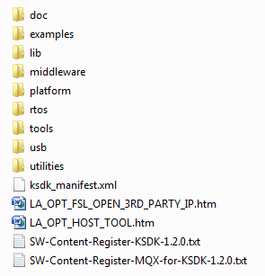
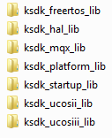
Directory Structure
Generated documentation
Projects for compiling libs
Demonstration projects
FATFS and LWIP middleware source
Eclipse update and CMake toolchain files
RTOS source code and libraries
USB stack source and libraries
USB stack source and libraries

Slide 21
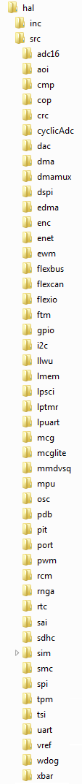
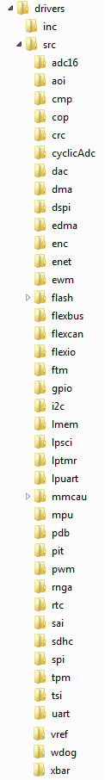
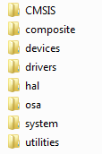
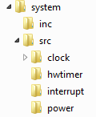
Directory Structure (Platform)
System services

Slide 22
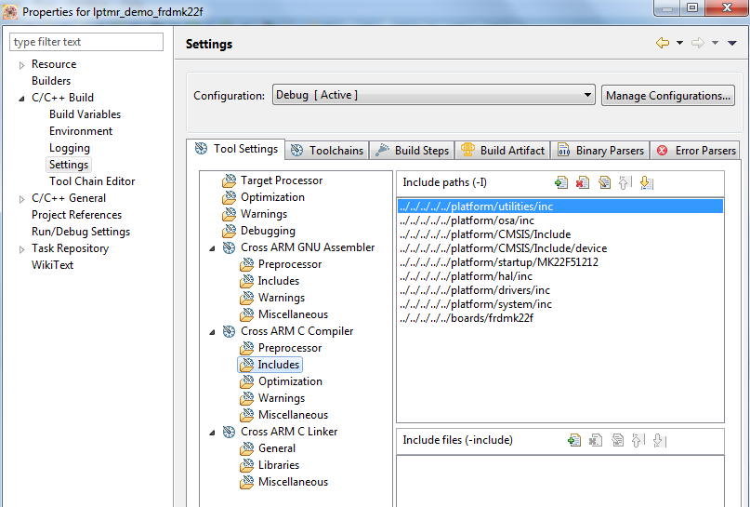
Kinetis SDK Project Information
Right click on lptmr project and select Properties
Navigate to the C/C++ Build->Settings page
Look at the Cross ARM C Compiler->Includes screen to see how the Kinetis SDK directories are included
Notes:
Just show in KDS

Slide 23
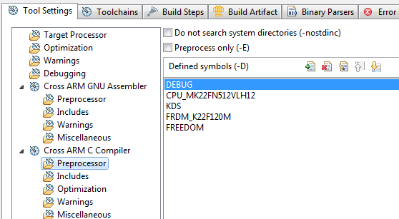
Kinetis SDK Project Information Continued
Look at the Preprocessor screen to see the various Kinetis SDK defines

Slide 24
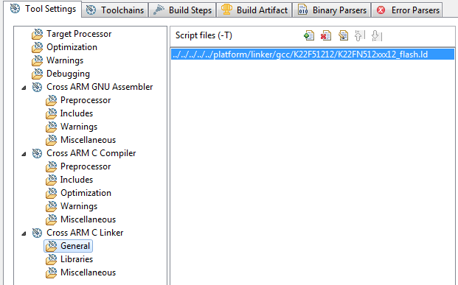
Kinetis SDK Project Information Continued
Linker File

Slide 25
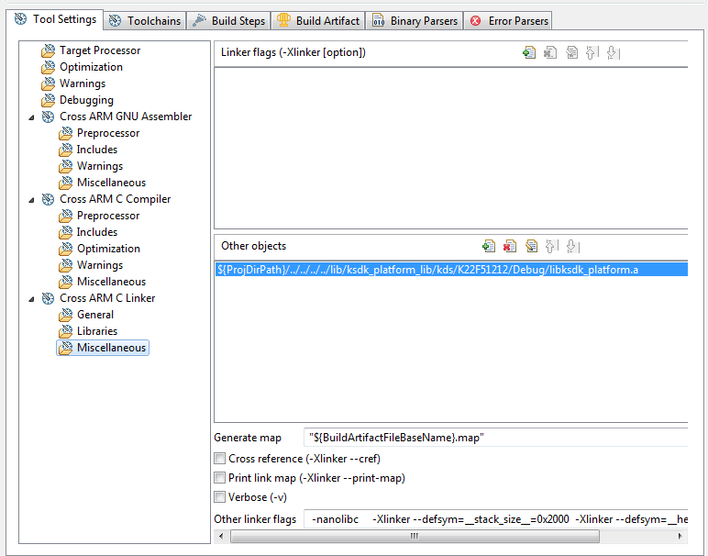
Kinetis SDK Project Information Continued
Kinetis SDK Platform Library

Slide 26
Agenda
In-Depth Kinetis SDK
Advanced Kinetis SDK Project Creation
Lab
In-Depth on Kinetis SDK System Services
Lab
Middleware Stacks
In-Depth on Kinetis SDK Startup and Porting
Lab
Tips and Tricks
Conclusion

Slide 27
SDK Project Generator Overview
Standalone utility designed to help users create custom SDK-based projects, within or outside of the SDK source tree
Cross-platform, supporting Windows, Mac OS and Linux
Highly customizable output:
Simple “Quick Generate” creates a barebones while(1) application in SDK tree
Advanced Configuration
Device selection by board or specific device
New project or clone an existing one
SDK library choice (full platform library or HAL only)
RTOS selection
IDE selection
Project can reside within or completely standalone from SDK source tree

Slide 28
SDK Project Generator – Quick Generate
Point to SDK installation
Name your project
Click on board image to visit the board’s product page
Select your board
Output is placed in the SDK tree in: <SDK_Install_Directory>/examples/<board>/user_apps
Create your project!

Slide 29
SDK Project Generator – Advanced Options
Click on the Advanced button to view advanced options
Project name and board selection are carried over

Slide 30
SDK Project Generator – Advanced, New-Device
New Project
Choose target based on device part number or board
Complete SDK Platform Library or HAL-only
IDE selection
RTOS selection
Include BSP files
Determines whether project output is in or out of SDK source tree

Slide 31
SDK Project Generator – Advanced, New-Board
New Project
Choose target based on device part number or board
Complete SDK Platform Library or HAL-only
IDE selection
RTOS selection
Include BSP files
USB option
Determines whether project output is in our out of SDK source tree

Slide 32
SDK Project Generator – Advanced, Clone
Clone Existing
Select project to clone
Determines whether project output is in our out of SDK source tree

Slide 33
Agenda
In-Depth Kinetis SDK
Advanced Kinetis SDK Project Creation
Lab
In-Depth on Kinetis SDK System Services
Lab
Middleware Stacks
In-Depth on Kinetis SDK Startup and Porting
Lab
Tips and Tricks
Conclusion

Slide 34
Advanced Project Creation Lab
Explore the advanced options of the Project Generator Tool
Output will be used for later lab
Notes:
The system services contain a set of software entities that can be used by Peripheral Drivers, or be used with HAL to build Peripheral Drivers or application directly.

Slide 35
Agenda
In-Depth Kinetis SDK
Advanced Kinetis SDK Project Creation
Lab
In-Depth on Kinetis SDK System Services
Lab
Middleware Stacks
In-Depth on Kinetis SDK Startup and Porting
Lab
Tips and Tricks
Conclusion

Slide 36
System Services
SDK functionality defined as System Services:
Clock Manager
Low Power Manager
Interrupt Manager
Hardware Timer
Are built on top of SoC CMSIS header files and HAL components
Called directly by the user application
User can use only the HAL and System Services to build applications
Notes:
The system services contain a set of software entities that can be used by Peripheral Drivers, or be used with HAL to build Peripheral Drivers or application directly.

Slide 37
Clock Manager

Slide 38
Clock Manager Overview
A high-level API that allows an application to manage and query system and peripheral clocking
Combines functionality from the Multipurpose Clock Generator (MCG), System Integration Module (SIM), Real-Time Clock (RTC) and Oscillator (OSC) peripherals into a single API set
Enables forcible or agreeable clock changes with optional application-defined callbacks

Slide 39
Where Can You Find The Clock Manager?
System Services are located in the ./platform/system folder of the SDK tree.
Header files are in the inc folder
In the src folder, each System Service module has its own container folder. For the clock manager, the folder is called clock
The Clock Manager is layered:
Common functions (across all FSL platforms) are located in the top level fsl_clock_manager.c file, which resides in ./platform/system/src/clock
Device-specific functions and feature implementations reside in a MCU family sub-folder within ./platform/system/src/clock. For example, the FRDM-K22F’s implementation is in ./platform/system/src/clock/MK22F51212

Slide 40
Clock Manager Source Hierarchy
The user application only includes fsl_clock_manager.h, everything else is automatically pulled in.
fsl_clock_manager.h
fsl_clock_<device>.h
fsl_clock_manager.c
fsl_clock_<device>.c
MCG/MCG-Lite HAL
SIM HAL
RTC HAL
OSC HAL
CMSIS Header Files (direct register access)

Slide 41
Clock Manager Application Usage
The Clock Manager supports two usage models:
Simplified: Application calls CLOCK_SYS_SetConfiguration() and is responsible for notifying or updating peripherals prior to changing the clock.
Managed: The Clock Manager is provided with a set of clock configurations to manage and can notify peripherals or application modules of changes via callback functions.
Managed mode is effectively a wrapper around CLOCK_SYS_SetConfiguration() – with the added intelligence to provide callback functions.

Slide 42
Clock Manager “Simplified” Usage Example
osc_user_config_t osc0Config =
{
.freq = OSC0_XTAL_FREQ,
.hgo = MCG_HGO0,
.range = MCG_RANGE0,
.erefs = MCG_EREFS0,
.enableCapacitor2p = OSC0_SC2P_ENABLE_CONFIG,
.enableCapacitor4p = OSC0_SC4P_ENABLE_CONFIG,
.enableCapacitor8p = OSC0_SC8P_ENABLE_CONFIG,
.enableCapacitor16p = OSC0_SC16P_ENABLE_CONFIG,
};
// Configure the OSC.
CLOCK_SYS_OscInit(0U, &osc0Config);
// Set system, bus, flash and FlexBus clocks.
CLOCK_SYS_SetConfiguration(&g_defaultClockConfigRun);
const clock_manager_user_config_t g_defaultClockConfigRun =
{
.mcgConfig =
{
.mcg_mode = kMcgModePEE, // Work in PEE mode.
.irclkEnable = true, // MCGIRCLK enable.
.irclkEnableInStop = false, // MCGIRCLK disable in STOP mode.
.ircs = kMcgIrcSlow, // Select IRC32k.
.fcrdiv = 0U, // FCRDIV is 0.
.frdiv = 3U,
.drs = kMcgDcoRangeSelLow, // Low frequency range
.dmx32 = kMcgDmx32Default, // DCO has a default range of 25%
.oscsel = kMcgOscselOsc, // Select OSC
.pll0EnableInFllMode = false, // PLL0 disable
.pll0EnableInStop = false, // PLL0 disable in STOP mode
.prdiv0 = 0x3U,
.vdiv0 = 0x10U,
},
.simConfig =
{
.pllFllSel = kClockPllFllSelPll, // PLLFLLSEL select PLL.
.er32kSrc = kClockEr32kSrcRtc, // ERCLK32K selection, use RTC.
.outdiv1 = 0U,
.outdiv2 = 1U,
.outdiv3 = 2U,
.outdiv4 = 3U,
},
.oscerConfig =
{
.enable = true, // OSCERCLK enable.
.enableInStop = false, // OSCERCLK disable in STOP mode.
.erclkDiv = 0U, // OSCERCLK divider setting.

Slide 43
Clock Manager “Managed” Usage Example
// Configure the OSC.
CLOCK_SYS_OscInit(0U, &osc0Config);
// Initialize Clock Manager.
CLOCK_SYS_Init(&g_defaultClockConfigurations, NUM_CONFIGS, clockCallbackTable, NUM_CALLBACKS);
// Set clock configuration to RUN mode.
CLOCK_SYS_UpdateConfiguration(RUN_MODE, kClockManagerPolicyForcible);
// Set clock configuration to VLPR mode.
CLOCK_SYS_UpdateConfiguration(VLPR_MODE, kClockManagerPolicyForcible);
#define NUM_CONFIGS 3U
#define VLPR_MODE 1U
#define RUN_MODE 2U
const clock_manager_user_config_t * g_defaultClockConfigurations[] =
{
NULL,
&g_defaultClockConfigVlpr,
&g_defaultClockConfigRun
};
#define NUM_CALLBACKS 1U
static clock_manager_callback_user_config_t *clockCallbackTable[] =
{
&userAppClockCalback
};

Slide 44
Callback Implementation Example
clock_manager_error_code_t
userAppClockCallback(clock_notify_struct_t *notify, void* dataPtr)
{
clock_manager_error_code_t result = kClockManagerSuccess;
switch (notify->notifyType)
{
case kClockManagerNotifyBefore:
/* TODO */
/* Add code here. */
break;
case kClockManagerNotifyRecover:
/* TODO */
/* Add code here. */
break;
case kClockManagerNotifyAfter:
/* TODO */
/* Add code here. */
break;
default:
result = kClockManagerError;
break;
}
return result;
}
Notification structure includes notification type, policy and the target clock configuration index
Application-defined data can be passed into or out of a callback.

Slide 45
Clock Manager Additional Functionality
// Configure the RTC oscillator.
CLOCK_SYS_RtcOscInit(0U, &rtcOscConfig);
// Get values of various clocks.
sys_clk = CLOCK_SYS_GetSystemClockFreq();
bus_clk = CLOCK_SYS_GetBusClockFreq();
flash_clk = CLOCK_SYS_GetFlashClockFreq();
// Update clock divider values.
CLOCK_SYS_SetOutDiv1(2);
CLOCK_SYS_SetOutDiv2(4);
CLOCK_SYS_SetOutDiv3(4);
CLOCK_SYS_SetOutDiv4(4);
// Enable UART0 clock gate.
CLOCK_SYS_EnableUartClock(0);
// Disable UART0 clock gate.
CLOCK_SYS_DisableUartClock(0);
// Get UART0 clock value.
uart_clk = CLOCK_SYS_GetUartFreq(0);
// Set LPUART0’s clock source.
CLOCK_SYS_SetLpuartSrc(0, kClockLpuartSrcIrc48M);
rtc_osc_user_config_t rtcOscConfig =
{
.freq = RTC_XTAL_FREQ,
.enableCapacitor2p = RTC_SC2P_ENABLE_CONFIG,
.enableCapacitor4p = RTC_SC4P_ENABLE_CONFIG,
.enableCapacitor8p = RTC_SC8P_ENABLE_CONFIG,
.enableCapacitor16p = RTC_SC16P_ENABLE_CONFIG,
.enableOsc = RTC_OSC_ENABLE_CONFIG,
.enableClockOutput = RTC_CLK_OUTPUT_ENABLE_CONFIG,
};

Slide 46
Power Manager

Slide 47
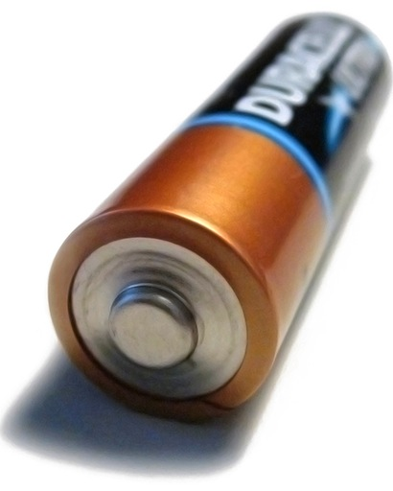
Power Manager Overview
A high-level API that allows an application to easily manage and utilize its supported power modes
Provides the ability to execute application-defined callbacks before or after power mode transitions
Enables agreeable or forcible transition between power modes, allowing peripherals to hold-off transition requests or the application to force transition

Slide 48
Where Can You Find The Power Manager?
System Services are located in the ./platform/system folder of the SDK tree.
Header files are in the inc folder
In the src folder, each System Service module has its own container folder. For the power manager, the folder is called power

Slide 49
Power Manager Overview — Initialization
The application defines the supported power modes
This will typically be a subset of what the specific MCU supports since it’s application-specific
Supported modes are defined as structures and passed into POWER_SYS_Init()
Callbacks are defined during device initialization and also passed into POWER_SYS_Init()

Slide 50
Power Manager Interaction
The Power Manager only touches the SMC, PMC and RCM registers, which are the main blocks needed to transition into a low power state
The Power Manager does not configure wake-up sources or adjust clock frequencies. The application, or other System Services, are responsible for enabling and configuring wake-up and clock adjustments.
The Power Manager relies on user-defined callback functions to interact with other application components
For example, if pin muxing needs to be adjusted prior to changing power mode, a “before” callback should be used
Allows for user-defined data to be passed into the callback functions. This data can then be used by the application to determine state or perform tasks

Slide 51
Power Manager Initialization
power_manager_user_config_t vlprConfig =
{
.mode = kPowerManagerVlpr,
.sleepOnExitValue = false,
.lowPowerWakeUpOnInterruptValue = kSmcLpwuiDisabled,
.powerOnResetDetectionValue = kSmcPorDisabled,
.RAM2PartitionValue = kSmcRam2DisPowered,
.partialStopOptionValue = kSmcPstopStop,
.lowPowerOscillatorValue = kSmcLpoDisabled
};
POWER_SYS_Init(powerConfigs, NUM_CONFIGS,
powerCallbacks, NUM_CALLBACKS);
#define NUM_CONFIGS 4U
power_manager_user_config_t const *powerConfigs[] =
{
&vlprConfig,
&runConfig,
&waitConfig,
&stopConfig
};
#define NUM_CALLBACKS 1U
power_manager_callback_user_config_t * powerCallbacks[] =
{
&userAppPowerCallbackCfg
};
// User callback data
user_callback_data_t callbackData;
power_manager_callback_user_config_t userAppPowerCallbackCfg =
{
userAppPowerCallback,
kPowerManagerCallbackBeforeAfter,
(power_manager_callback_data_t*) &callbackData
};

Slide 52
Changing Power Modes
Changing power modes is very easy with the Power Manager.
Based on the policy of the selected power configuration, the Power Manager can either force entry (forcible) or abort if the user callback signals it is not ready (agreeable)
power_manager_error_code_t POWER_SYS_SetMode(uint8_t powerModeIndex)
Index of desired user-defined power mode
power_manager_user_config_t const *powerConfigs[] =
{
&vlprConfig,
&runConfig,
&waitConfig,
&stopConfig
};
This is what the index refers to

Slide 53
Interrupt Manager

Slide 54
Interrupt Manager Overview
Enable or disable system interrupts at the NVIC level
Global enable/disable of system interrupts
Dynamically register/install interrupt service routines (ISRs) into systems that utilize a RAM-based vector table
To set interrupt priorities, leverage the NVIC_* APIs defined in the CMSIS header file

Slide 55
Agenda
In-Depth Kinetis SDK
Advanced Kinetis SDK Project Creation
Lab
In-Depth on Kinetis SDK System Services
Lab
Middleware Stacks
In-Depth on Kinetis SDK Startup and Porting
Lab
Tips and Tricks
Conclusion

Slide 56
System Services Lab
Explore the Low Power Manager

Slide 57
Agenda
In-Depth Kinetis SDK
Advanced Kinetis SDK Project Creation
Lab
In-Depth on Kinetis SDK System Services
Lab
Middleware Stacks
In-Depth on Kinetis SDK Startup and Porting
Lab
Tips and Tricks
Conclusion

Slide 58
Kinetis MCU Unified USB Stack

Slide 59

Freescale USB Stack
Learn more at: www.freescale.com/usb
Product Features
USB stack with all sources provided
Low footprint: down to 7 KBytes Flash and 2.5 KBytes RAM
Integrated with Kinetis SDK and MQX 4.2
Device classes
HID, CDC, PHDC, MSC, AUDIO
Host classes
HID, CDC, PHDC, MSC, AUDIO
USB OTG
HNP, SRP
New 'unified' stack combines MQX and Bare Metal stack
Support for IAR, Keil, Kinetis Design Studio, and GNU/GCC tool chains.
Enable USB applications with Freescale Devices.
Different USB host and device classes, both bare metal, RTOS and integrated with Kinetis SDK.
Software and Hardware
Evaluation & Dev Tools
Customer Application
Stacks
(TCP/IP, USB)
Middleware
Application Specific
Libraries
(DSP, Math, Encryption)
Operating System
BSP, Drivers & HAL
Bootloader
MCU Hardware

Slide 60
Architecture
Applications
Mouse
Medical
USB Serial
Storage
Audio
OSA
OS
(BM/
MQX/
SDK)
Class Driver
HID
PHDC
CDC
MSC
AUDIO
Peripheral Driver
Common Peripheral Layer
Controller driver
Full speed Controller driver
High speed controller driver
HAL
Full speed Controller driver
High speed controller driver
HW
Full speed Controller driver
High speed controller driver

Slide 61
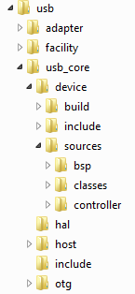

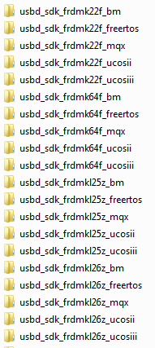
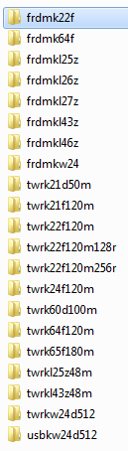

Kinetis SDK USB Folder Structure

Slide 62
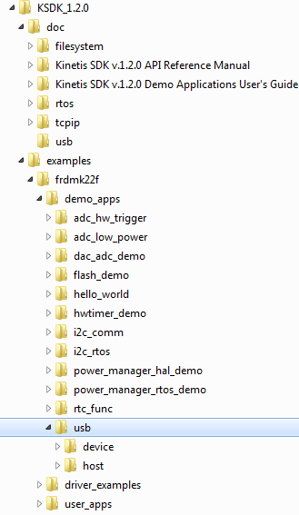
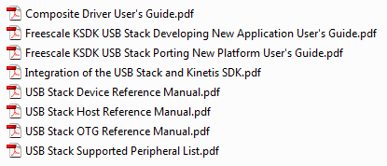

Kinetis SDK USB Examples and Documentation

Slide 63
USB Examples
The USB examples that come with Kinetis SDK require 2 libraries to be built first:
Kinetis SDK Platform Library
USB Host or Device Library (depending on if example is host or device)
As an example, to run the Device HID Mouse example on FRDM-K22F with KDS would need to import and compile:
<ksdk_dir>\lib\ksdk_platform_lib\kds\K22F51212
<ksdk_dir>\usb\usb_core\device\build\kds\usbd_sdk_frdmk22f_bm
<ksdk_dir>\examples\frdmk22f\demo_apps\usb\device\msd\bm\kds

Slide 64
TCP/IP

Slide 65
Lightweight IP (lwIP)
Version 1.4.1 (latest) code base
Open source, BSD-style license
Supports both IPv4 and IPv6
Main features include: - Protocols: IP, ICMP, UDP, TCP, IGMP, ARP, PPPoS, PPPoE - DHCP client, DNS client, AutoIP/APIPA (Zeroconf), SNMP agent (private MIB support) - APIs: specialized APIs for enhanced performance, optional Berkeley-like socket API - Extended features: IP forwarding over multiple network interfaces, TCP congestion control, RTT estimation and fast recovery/fast re-transmit - Add-on applications: HTTP server, SNTP client, SMTP client, ping, NetBIOS name server

Slide 66
RTCS
Requires MQX RTOS
Supports IPv4 and IPv6 (with add-on)
TCP, UDP, ARP, ICMP, CIDR, IGMP, and PPP
Application-layer protocols such as DNS resolver only, DHCP, HTTP, FTP, TFTP, Telnet, SMTP, SNMPv1, and SNMPv2
Provides a Berkeley Socket (BSD) API and supports stream and datagram sockets
Additional features:
high-performance, re-entrant operation
multihoming and multiple devices
dynamically configurable gateways
network status and diagnostics

Slide 67
TCP/IP Comparison (as delivered in KSDK)
Criteria | RTCS | LwIP
IPV6 | YES | YES
POSIX- like interface | YES | Optional
TCP | YES | YES
UDP | YES | YES
PPP | YES | YES
HTTP | YES | ADD-ON
ICMP | YES | YES
SNMP | YES | YES
FTP | YES
TFTP | YES
DNS | YES | YES
Telnet | YES
SMTP | YES | ADD-ON
NAT | YES

Slide 68
File Systems

Slide 69
File System Comparison (as delivered in KSDK)
Criteria | MFS | FatFS
FAT Formats Supported | FAT-12,-16, -32 | FAT-12,-16, -32
Reentrancy | YES | NO
API compliancy | POSIX | ANSI-C
Multiple partitions | YES | NO
Multiple instances | YES | NO
SDCARD driver | KSDK | KSDK
USB MSD driver | KSDK | KSDK
RAMDISK driver | YES
FAT cached access | YES
Data cached access | YES
Directory cached acc. | YES

Slide 70
OS Abstraction (OSA)

Slide 71
OS Abstraction Layer Overview
Enables Kinetis SDK to work with different RTOSes and provides common API for drivers to use
Support key RTOS services
Semaphores, Mutex, Memory Management, Events, more…
Implementation for different RTOSes
Bare Metal
MQX, FreeRTOS, uCOS-II, and uCOS-III
Does not abstract ISRs
ISRs must be set up slightly different depending on the RTOS used
Some RTOS require prologue and epilogue for ISR enter and exit
Some RTOS require ISR entries be registered with RTOS-specific ISR registration function

Slide 72


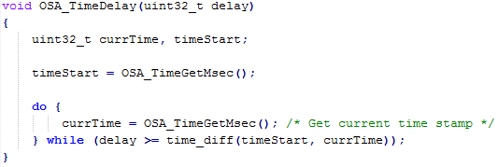
OS Abstraction Layer Example: OSA_TimeDelay()
Translation code found in \platform\osa
For MQX maps to:
For FreeRTOS maps to:
For Baremetal maps to:
Notes:
OSA_TimeDelay is a simple example, but works in similar fashion for other RTOS features like task creation, semaphores, and more

Slide 73
OS Abstraction Layer
The OSA layer allows the same user code to be compatible with multiple RTOSes
See I2C_rtos example in Kinetis SDK
Same software works with bare-metal, MQX, FreeRTOS, uCOS
Still have option of using direct RTOS function calls
Use either OSA_TimeDelay(500) or _time_delay(500)
Most drivers use OSA for timers, and thus must call OSA_Init()

Slide 74
Agenda
In-Depth Kinetis SDK
Advanced Kinetis SDK Project Creation
Lab
In-Depth on Kinetis SDK System Services
Lab
Middleware Stacks
In-Depth on Kinetis SDK Startup and Porting
Lab
Tips and Tricks
Conclusion

Slide 75
Kinetis SDK Startup

Slide 76
Kinetis SDK Startup
Kinetis SDK has a very short startup
Disable Watchdog
Initialize RAM
Most chip/board configuration happens from user application
Utilize helper functions to initialize clocks and modules

Slide 77
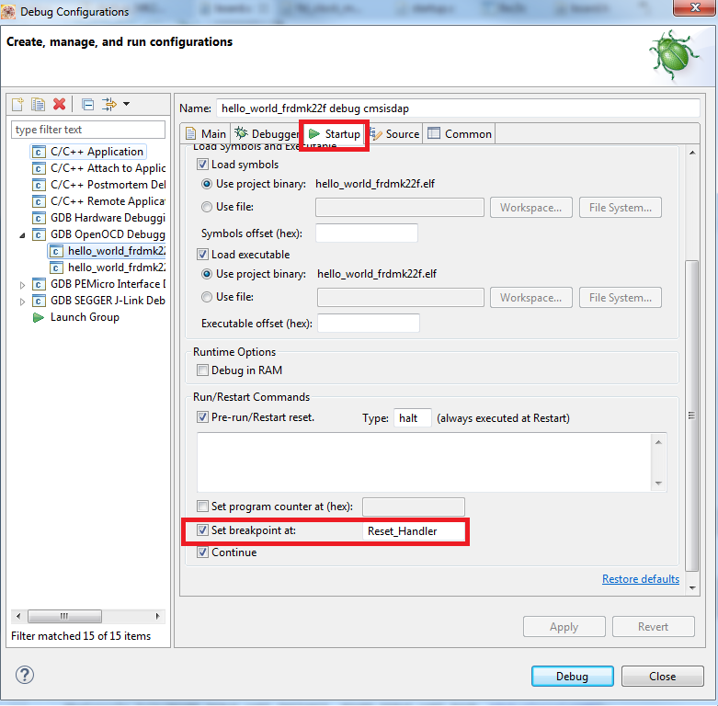
Explore KSDK Startup via the Debugger

Slide 78
KSDK Startup
__Reset_Handler()
Calls other init functions
system_MK22F51212.c
startup_MK22F51212.s
SystemInit()
Disable watchdog,
Configure cache
Chip Specific
init_data_bss()
Optionally relocate Vector table to RAM,
Standard C startup: .bss, variables
Board Specific
startup.c
Application Specific
main()
Call hardware_init
Start application
pin_mux.c
main.c
configure_<module>_pins()
Initializes pin muxing for a module
Pass-in instance of module
hardware_init()
Calls pin mux functions, setup clock,
Initialize UART
hardware_init.c
Board_ClockInit()
Configure clock using Clock Manager
board.c
main()
Continue Application
main.c
dbg_uart_init()
Initialize UART pins
Initialize debug console
board.c

Slide 79
Kinetis SDK Startup
Reset_Handler
\platform\devices\MK22F51212\startup\<compiler>\startup_MK22F51212.s
Calls basic init functions before going to main
systemInit
\platform\devices\MK22F51212\startup\system_MK22F51212.c
Generated by Processor Expert.
Enable cache, disable watchdog
Option to setup clocks
CLOCK_SETUP #define is depreciated with KSDK 1.2
init_data_bss
\platform\devices\startup.c
Initializes RAM
main
main.c (app specific)

Slide 80
Kinetis SDK Startup – Hardware_Init
All clock and pin muxing are called from user application via hardware_init()
Hardware_init is application specific and found in application directory
Calls:
configure_<module>_pins
\examples\<board>\pin_mux.c
Configures pin muxing for a module
Uses macro that maps to pin_mux_<module>
BOARD_ClockInit()
\examples\<board>\board.c
Initialize particular clocking scheme
dbg_uart_init
\examples\<board>\board.c
Initialize UART pins and module

Slide 81
Porting Kinetis SDK to custom hardware

Slide 82
Porting KSDK to Custom Hardware
Two Main Porting Concerns:
Changing to new subset device
Changing to new board layout
Porting to New Subset Device:
Freescale development boards use superset derivatives
Custom hardware can use derivative with differences in memory, peripherals, and pins
Port Example: from MK64FN1M0VMD12 to MK24FN1M0VLQ12
Porting to New Board Layout:
Different pins used
Different peripherals connected
Also might be interested in changing clock configurations
Internal or external clock sources
Different frequencies for core, peripheral bus, and others

Slide 83
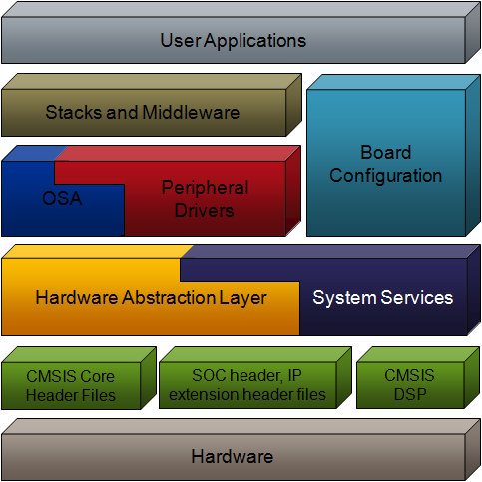
Hardware Porting Changes
Minimal Changes Required
OS, Application, Middleware do not need to change — they reside on top of HAL and peripheral drivers
HAL and Peripheral drivers do not need to change — they already support different Kinetis derivatives
Kinetis Derivative Differences
Kinetis SDK has derivative information
Specify derivative when compiling
Kinetis SDK pulls in correct header files
Board Configuration
Specific to hardware, needs customized
Pin Muxing
GPIO Configuration
Clock startup configuration

Slide 84
Porting to subset device

Slide 85
Changing to Kinetis Subset Derivative
Kinetis SDK makes changing to a subset derivative easy
Kinetis SDK already has derivative information in source code
Macros used at compile time
Specify peripheral differences between Kinetis derivatives like <KSDK_PATH>\platform\hal\adc\fsl_adc16_features.h
Specify which KSDK header files to include in build like <KSDK_PATH> \platform\CMSIS\Include\device\fsl_device_registers.h
Kinetis SDK uses compiler preprocessor definition to specify derivative.
Change in ksdk_platform_lib project and rebuild

Slide 86
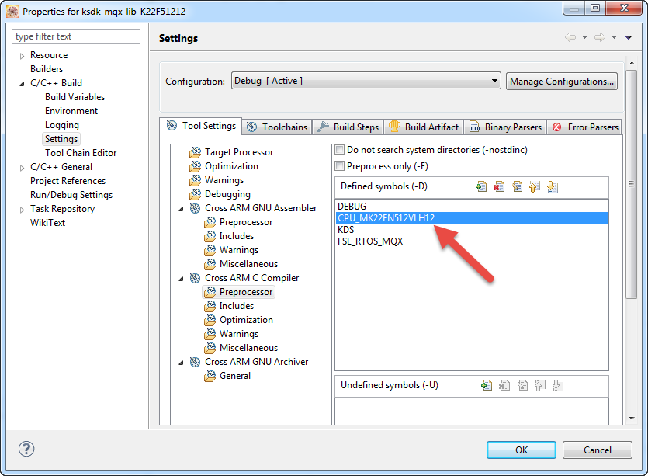
KDS Example: Derivative Defined in project

Slide 87
Derivative Details
The symbol to use for derivative based on Kinetis part number, like CPU_MK22FN512VLH12
Change in the toolchain compiler preprocessor settings for the library project ksdk_platform_lib
Kinetis SDK already includes supported derivatives
Can find all derivative options in <KSDK_PATH> \platform\CMSIS\Include\device\fsl_device_registers.h
Porting to a new family is not supported. Only derivatives.
Full list of supported derivatives can be found in the Release Notes

Slide 88
Porting to new board layout

Slide 89
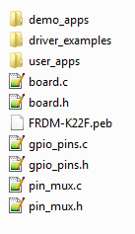
Custom Board Configuration
Each development board supported by Kinetis SDK has board configuration files
Found in <KSDK_PATH>/examples/<board_name>
Contains board-specific details for Kinetis SDK
Applications easily portable across different boards and devices
These files should be reviewed and modified for custom hardware:
board.c and board.h
pin_mux.c and pin_mux.h
gpio_pins.c and gpio_pins.h
hardware_init.c

Slide 90
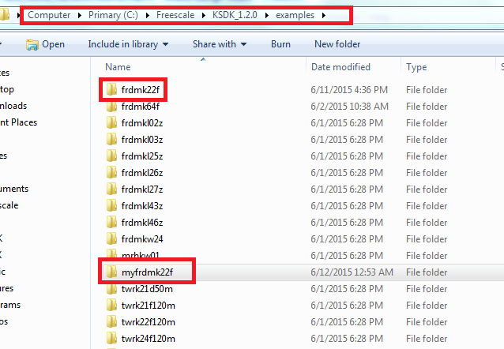
New Board Support
Copy and rename closest board folder in the examples directory

Slide 91
board.h file
Defines debug UART peripheral and pins
For stdin/stdout functions, like printf()
Mainly used for Kinetis SDK examples, specifying:
Features available on board, like sensor for demos
Peripheral instances for examples, like I2C0
Pins for LEDs and buttons

Slide 92
board.c file
Defines clock structures
BOARD_ClockInit()
Uses clock manager to configure the system clocks

Slide 93
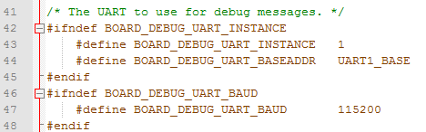
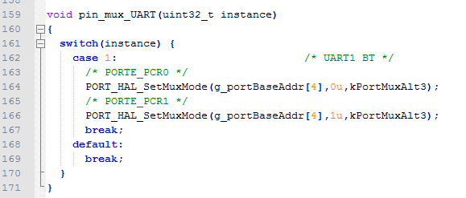
Kinetis SDK Porting — Change Default UART
Modify board.h to select the UART and baud rate to use
Modify pin_mux.c to select the pins to use

Slide 94
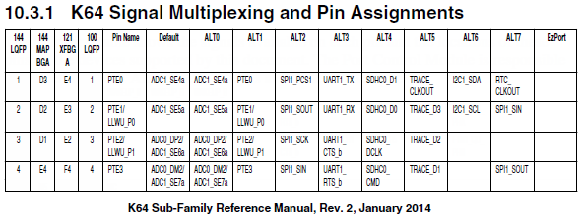
pin_mux.c and pin_mux.h
Kinetis devices provide great flexibility in muxing signals
Each digital port pin has up to 8 signals muxed on pin
Some peripherals route same signals to multiple pins
pin_mux.c:
Functions to set pin mux options for all pins used on board
Function for each peripheral type, like configure_can_pins()
Hardware_init.c calls these functions in pin_mux.c during startup

Slide 95
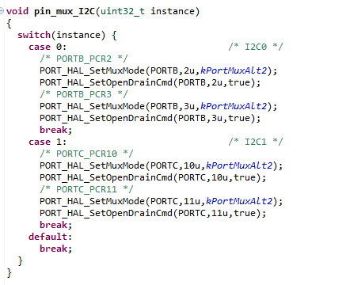
pin_mux.c and pin_mux.h
Not all instances will be populated so may need to add
Also some modules come out from more than one place, so check that desired pins are being used

Slide 96
gpio_pins.c and gpio_pins.h
Kinetis SDK uses pin configuration structures for each pin
Pin configuration structures in gpio_pin.c, configures
Input/output
Pull-up/pull-down enabled
Pin filtering
Interrupt enabled/disabled
Initial output polarity
Slew rate and drive strength setting
gpio_pins.h declares
Pin names used by board
PORT pin to use (ie: PTE3)

Slide 97
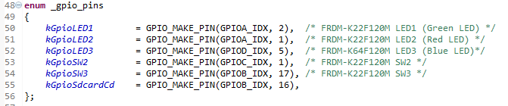
gpio_pins.h
Contains definitions for LED, Switch, and SD Card chip select

Slide 98
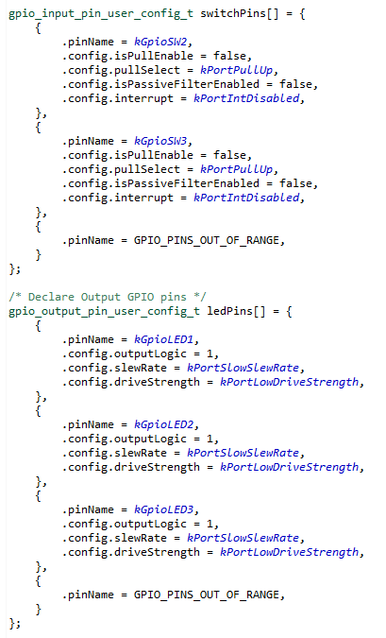
gpio_pins.c
Contains GPIO options
for each pin

Slide 99
GPIO Driver Uses Those Defines
GPIO_DRV_OutputPinInit(&ledPins[0]); //Init
GPIO_DRV_WritePinOutput(kGpioLED1, 1); //Turn On
GPIO_DRV_WritePinOutput(kGpioLED1, 0); //Turn Off

Slide 100
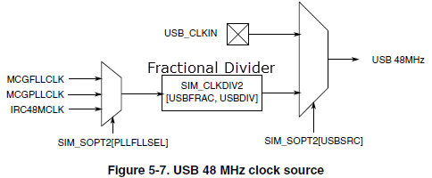
USB Hardware Porting
USB stacks have hardware-specific file
Device stack \usb\usb_core\device\sources\bsp\<Board>\usb_dev_bsp.c
Host stack \usb\usb_core\host\sources\bsp\<Board>\usb_host_bsp.c
OTG stack \usb\usb_core\otg\sources\bsp\<Board>\usb_otg_bsp.c
Modify this file if USB clock source or divider need to change

Slide 101
PEB
Processor Expert Configuration Files – PEB
Found for each board along with the other board files: C:\Freescale\KSDK_1.2.0\examples\<board_name>

Slide 102
Agenda
In-Depth Kinetis SDK
Advanced Kinetis SDK Project Creation
Lab
In-Depth on Kinetis SDK System Services
Lab
Middleware Stacks
In-Depth on Kinetis SDK Startup and Porting
Lab
Tips and Tricks
Conclusion

Slide 103
USB and Driver Lab
Lab will use the USB HID Device example
Will add code to use LED and I2C drivers

Slide 104
Agenda
In-Depth Kinetis SDK
Advanced Kinetis SDK Project Creation
Lab
In-Depth on Kinetis SDK System Services
Lab
Middleware Stacks
In-Depth on Kinetis SDK Startup and Porting
Lab
Tips and Tricks
Conclusion

Slide 105
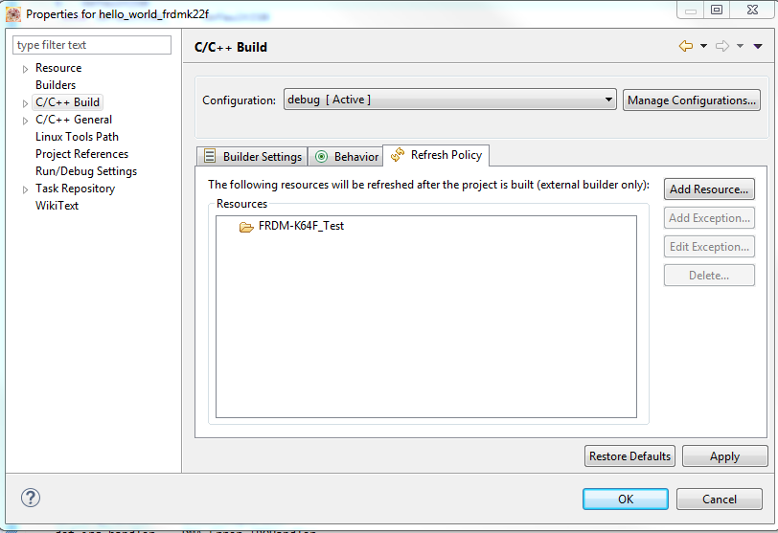
FYI: KDS Project Compilation
When debugging in KDS, the project will re-compile every time before downloading.
This is due to mismatched parameter in the Refresh Policy
Found in Project Properties->C/C++ Build->Refresh Policy tab

Slide 106
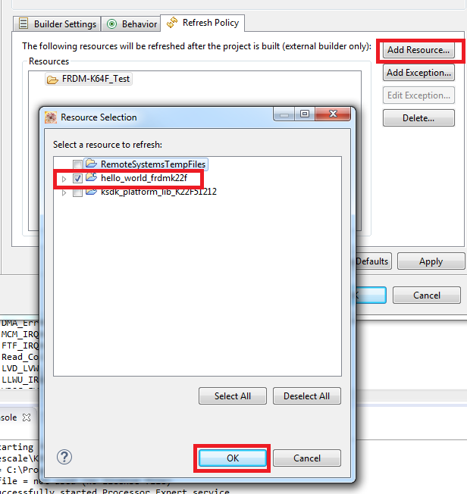
KDS Project Compilation – Add Correct Project
On Refresh Policy tab, click on Add Resource
Select the project and click OK

Slide 107
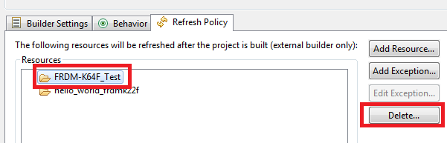
KDS Project Compilation – Remove Phantom Project
Now need to delete incorrect project
Click on FRDM-K64_Test
Click on the “Delete…” button
Finish by click “OK” to close out the dialog box

Slide 108
Tips for using Peripheral Drivers
Make sure to call OSA_Init()
Initializes timers used by drivers (ie for timeouts)
Makes use of LPTMR module
Make sure to include fsl_<module>_irq.c file in project
Otherwise will end up in default interrupt and driver will not work
The SPI and DSPI drivers are different and depend on device
Look at platform library to determine which version to use

Slide 109
KSDK Tips
KSDK enable MISRA checking by default
If using evaluation version of IAR, need to turn this off in the project settings
Not all projects use 115200 baud rate
Low power demo specifically uses 9600
Also some low end KL boards default to 9600
Example of using the FXOS8700 accelerometer can be found in K64F
\examples\frdmk64f\demo_apps\bubble_level_ftm
Can be re-used with other boards that use that accelerometer

Slide 110
Agenda
In-Depth Kinetis SDK
Advanced Kinetis SDK Project Creation
Lab
In-Depth on Kinetis SDK System Services
Lab
Middleware Stacks
In-Depth on Kinetis SDK Startup and Porting
Lab
Tips and Tricks
Conclusion

Slide 111
Summary

Slide 112
Session Summary
You should now be able to:
Understand how Kinetis SDK works
How to use the Project Generator tool to create custom projects
Understand how to use the clock and low power managers to make your application more efficient
Run Kinetis SDK on your own hardware
Use the knowledge and hands-on experience you have gained to quickly create applications using Freescale Kinetis MCUs

Slide 113
Additional Resources
Community
https://community.freescale.com/community/kinetis/kinetis-software-development-kit
https://community.freescale.com/community/kinetis
Web
www.freescale.com/ksdk
www.freescale.com/kds
www.freescale.com/freedom
www.freescale.com/mqx
www.freescale.com/usb
www.freescale.com/kboot

